Slide 1

Quantum CarbonRoute
AI Forecasting & Hybrid Quantum Optimization for CO₂ Reduction
Sadiya Ansari

Slide 2

Problem & Solution Hook
Problem:
Solution (The Thesis):
Current logistics optimize for Distance, but the real cost is CO₂.
We use a Hybrid AI + Quantum system to directly optimize the objective function for minimum CO₂ emissions.
Show the 2178 kg baseline number.
Theme Alignment: Sustainability.

Slide 3
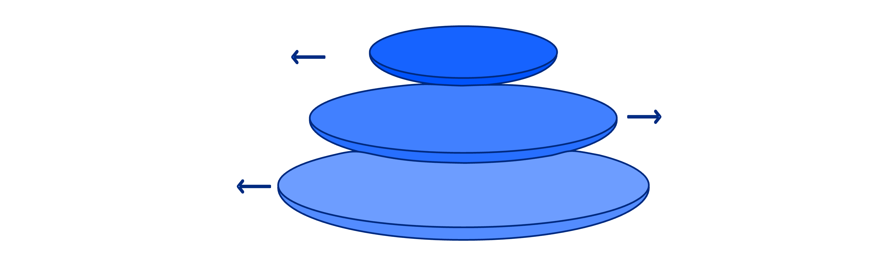
Technical Architecture
A clean, easy-to-read flow diagram.
Layer 1: AI
Demand prediction, mitigates uncertainty
Layer 2: Scaling
Graph coarsening and clustering
Layer 3: Optimization
Warm start + QUBO/DAQC refinement
Layer 1 (AI):
Layer 2 (Scaling):
Layer 3 (Optimization):
Demand Prediction (Mitigates Uncertainty).
Graph Coarsening / Clustering (Reduces problem size).
Classical Warm Start + QUBO/DAQC refinement (Finds the optimal path).
Key Jargon: Use it here, but keep it concise (e.g., "QUBO on Qiskit Aer").

Slide 4
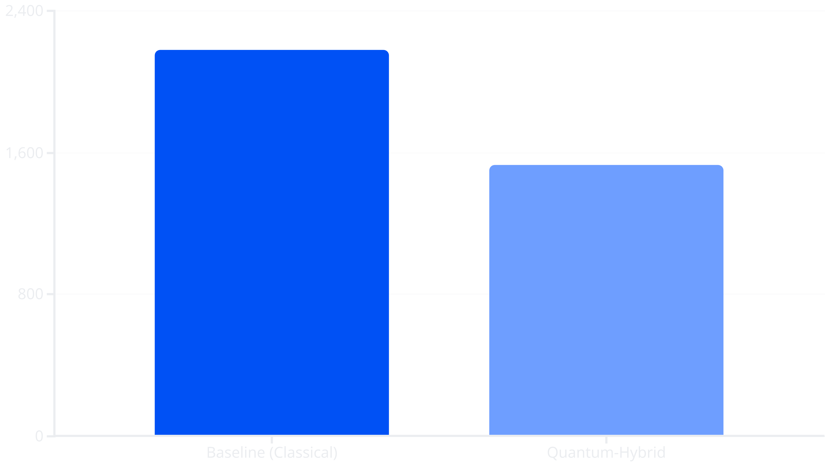
Results & Impact
A large, prominent graph or chart comparing the two solutions.
17.5% CO₂ Reduction
Impact: Thousands of tons saved annually.

Slide 5
Conclusion & Next Steps
Summary: We built a functional, end-to-end hybrid solution.
Next Steps:
Real quantum hardware integration
Real-time traffic data
Multi-depot routing

